Slide 1
CS 152 Computer Architecture and Engineering CS252 Graduate Computer Architecture Lecture 17 – RISC-V Vectors
Krste Asanovic
Electrical Engineering and Computer Sciences
University of California at Berkeley
http://www.eecs.berkeley.edu/~krste
http://inst.eecs.berkeley.edu/~cs152
Released Under Creative Commons CC BY-SA 4.0 Licence (see last slide)

Slide 2
Last Time in Lecture 16
GPU architecture
Evolved from graphics-only, to more general-purpose computing
GPUs programmed as attached accelerators, with software required to separate GPU from CPU code, move memory
Many cores, each with many lanes
thousands of lanes on current high-end GPUs
SIMT model has hardware management of conditional execution
code written as scalar code with branches, executed as vector code with predication

Slide 3
New RISC-V “V” Vector Extension
Being added as a standard extension to the RISC-V ISA
An updated form of Cray-style vectors for modern microprocessors
Appearing in commercial implementations from Alibaba, Andes, Semidynamics, SiFive, …
Basis of European supercomputer initiative (EPI)
Today, a short tutorial on current draft standard, v0.10
v0.10 is intended to be close to final version of RISC-V vector extension
Still a work in progress, so details might change before standardization
https://github.com/riscv/riscv-v-spec

Slide 4
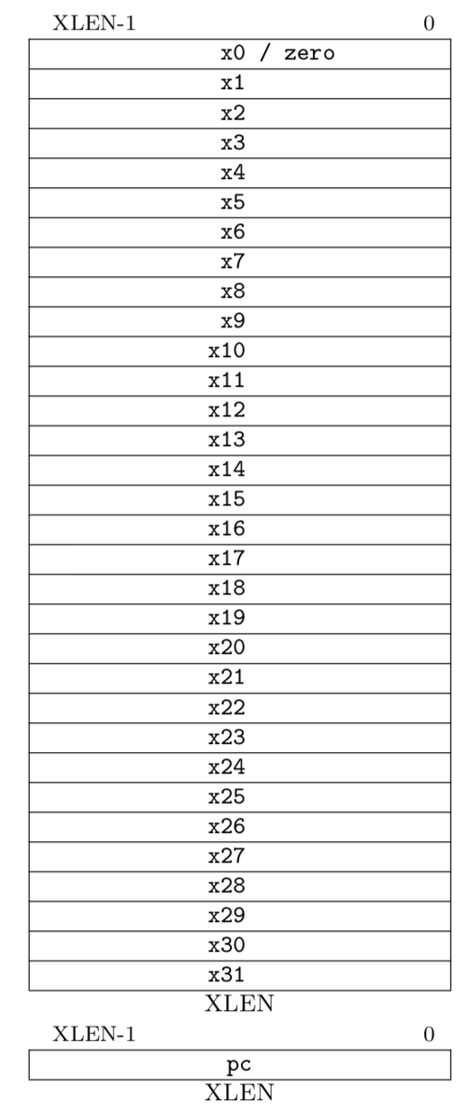
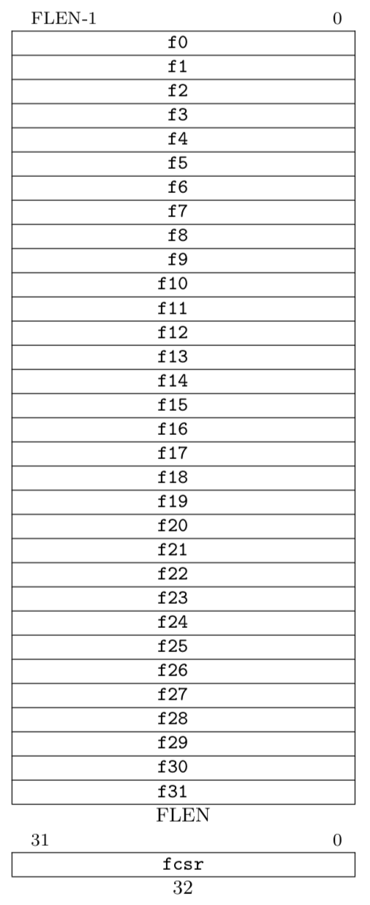
RISC-V Scalar State
Program counter (pc)
32x32/64-bit integer registers (x0-x31)
x0 always contains a 0
Floating-point (FP), adds 32 registers (f0-f31)
each can contain a single- or double-precision FP value (32-bit or 64-bit IEEE FP)
FP status register (fcsr), used for FP rounding mode & exception reporting
ISA string options:
RV32I (XLEN=32, no FP)
RV32IF (XLEN=32, FLEN=32)
RV32ID (XLEN=32, FLEN=64)
RV64I (XLEN=64, no FP)
RV64IF (XLEN=64, FLEN=32)
RV64ID (XLEN=64, FLEN=64)

Slide 5
Vector Extension Additional State
32 vector data registers, v0-v31, each VLEN bits long
Vector length register vl
Vector type register vtype
Other control registers:
vstart
For trap handling
vrm/vxsat
Fixed-point rounding mode/saturation
Also appear in separate vcsr
vlenb
Gives vector length in bytes (read-only)
Vector data registers
VLEN bits per vector register, (implementation-dependent)
v0
v31
Vector length register
vl
Vector type register
vtype

Slide 6
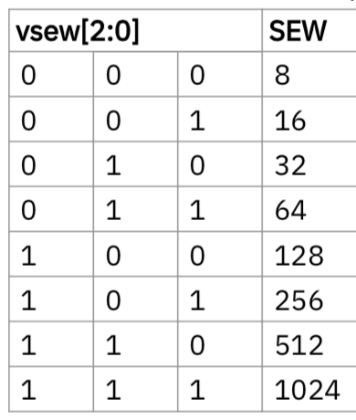
Vector Type Register (vtype)
Ideally, info would be in instruction encoding, but no space in 32-bit instructions.
Planned 64-bit encoding extension would add these as instruction bits.
vsew[2:0] field encodes standard element width (SEW) in bits of elements in vector register (SEW = 8*2^{vsew} )
vlmul[2:0] encodes vector register length multiplier (LMUL = 2^{vlmul} = 1/8 - 8)
vta specifies tail-agnostic
vma specifies mask-agnostic

Slide 7
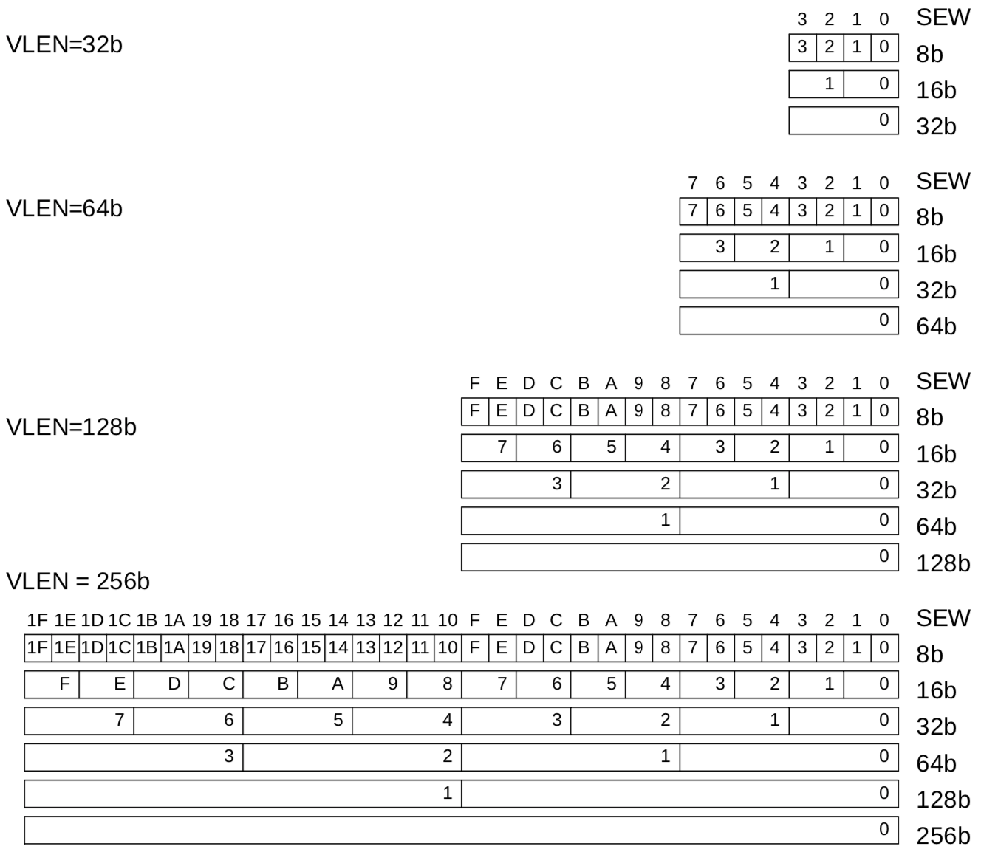
Example Vector Register Data Layouts (LMUL=1)

Slide 8
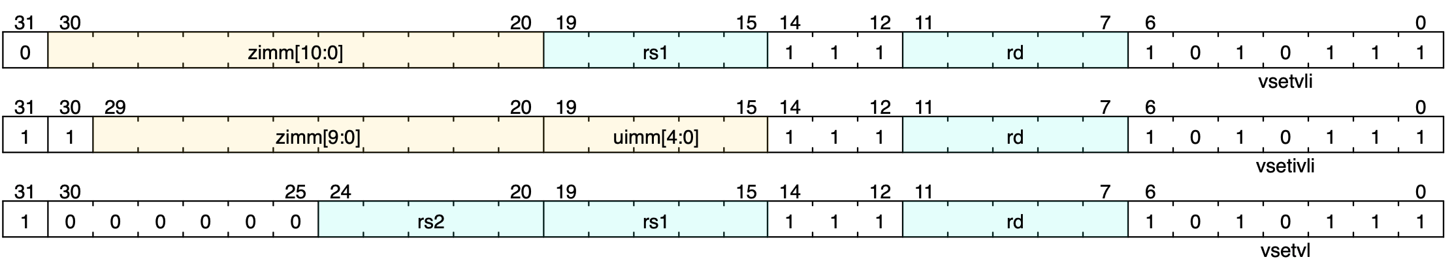
Setting vector configuration, vsetvli/vsetivli/vsetvl
The vset{i}vl{i} configuration instructions set the vtype register, and also set the vl register, returning the vl value in a scalar register
vsetvli rd, rs1, e8 # Set SEW=8, vl=min(VLEN/SEW,rs1), rd=vl
vtype parameters (SEW,LMUL,TA,MA) encoded as immediate in instruction
Resulting machine vector length setting
Requested application vector length
Instruction encoding
Usually use register-immediate form, vsetvli, to set vtype parameters.
Immediate-immediate form, vsetivli, used when vector length known statically
The register-register version vsetvl is usually used only for context save/restore

Slide 9
Vset{i}vl{i} operation
The first argument, rs1 or 5-bit immediate, is the requested application vector length (AVL)
The type argument (either 10/11-bit immediate or second register rs2) indicates how the vector registers should be configured
Configuration includes size of each element, SEW, and LMUL value
The vector length is set to the minimum of requested AVL and the maximum supported vector length (VLMAX) in the new configuration
VLMAX = LMUL*VLEN/SEW
vl = min(AVL, VLMAX)
The value placed in vl is also written to the scalar destination register rd

Slide 10
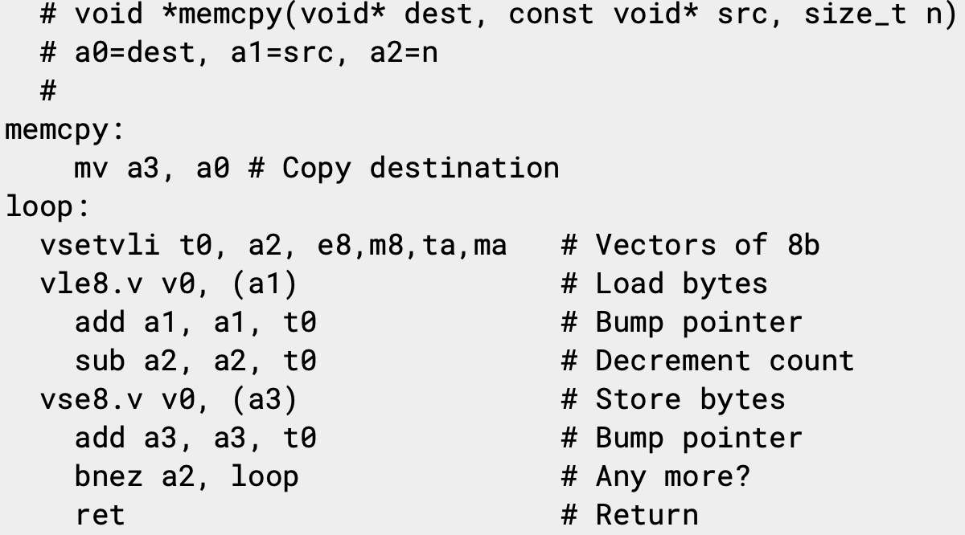
Simple stripmined vector memcpy example
Set configuration, calculate vector strip length
Unit-stride vector load elements (bytes)
Unit-stride vector store elements (bytes)
Same binary machine code can run on machines with any VLEN!

Slide 11
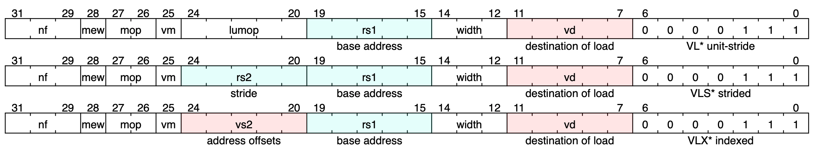
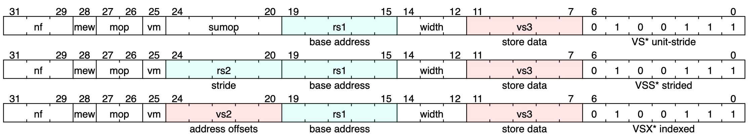
Vector Load and Store Instructions

Slide 12
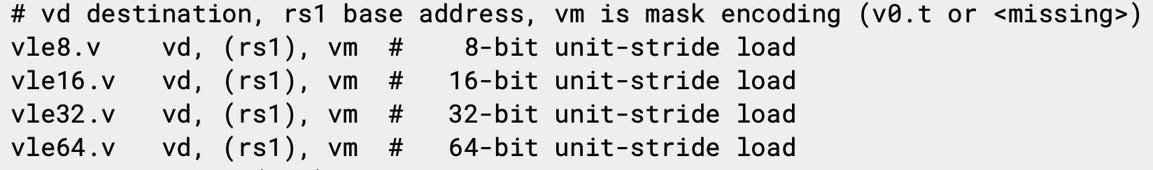
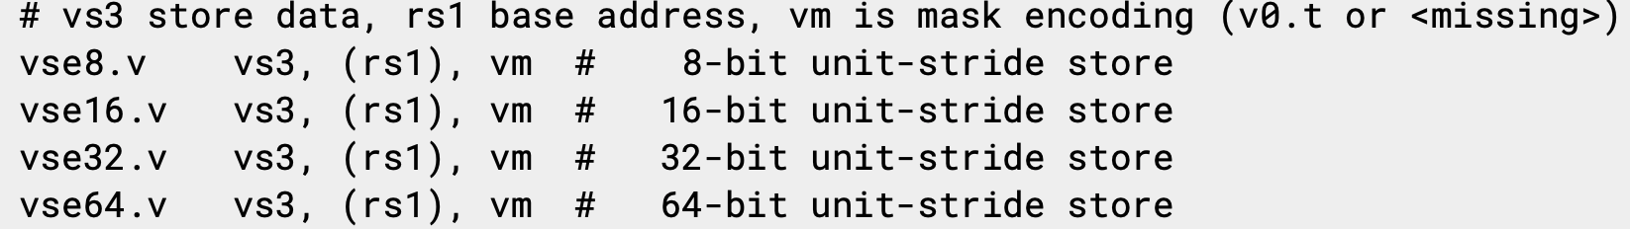
Vector Unit-Stride Loads/Stores

Slide 13
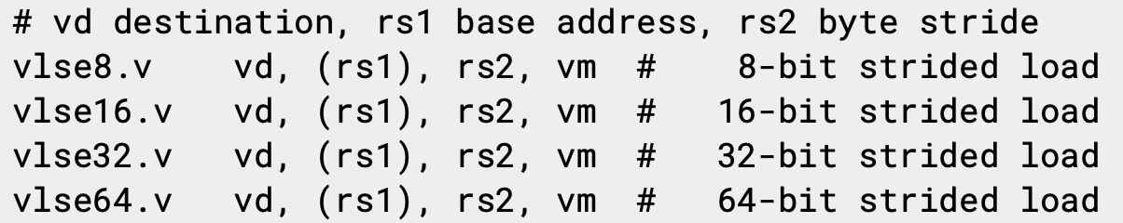
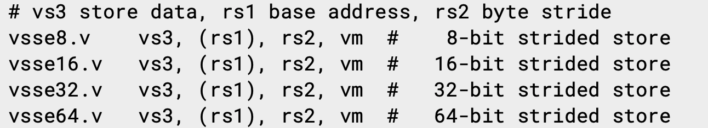
Vector Strided Load/Store Instructions

Slide 14
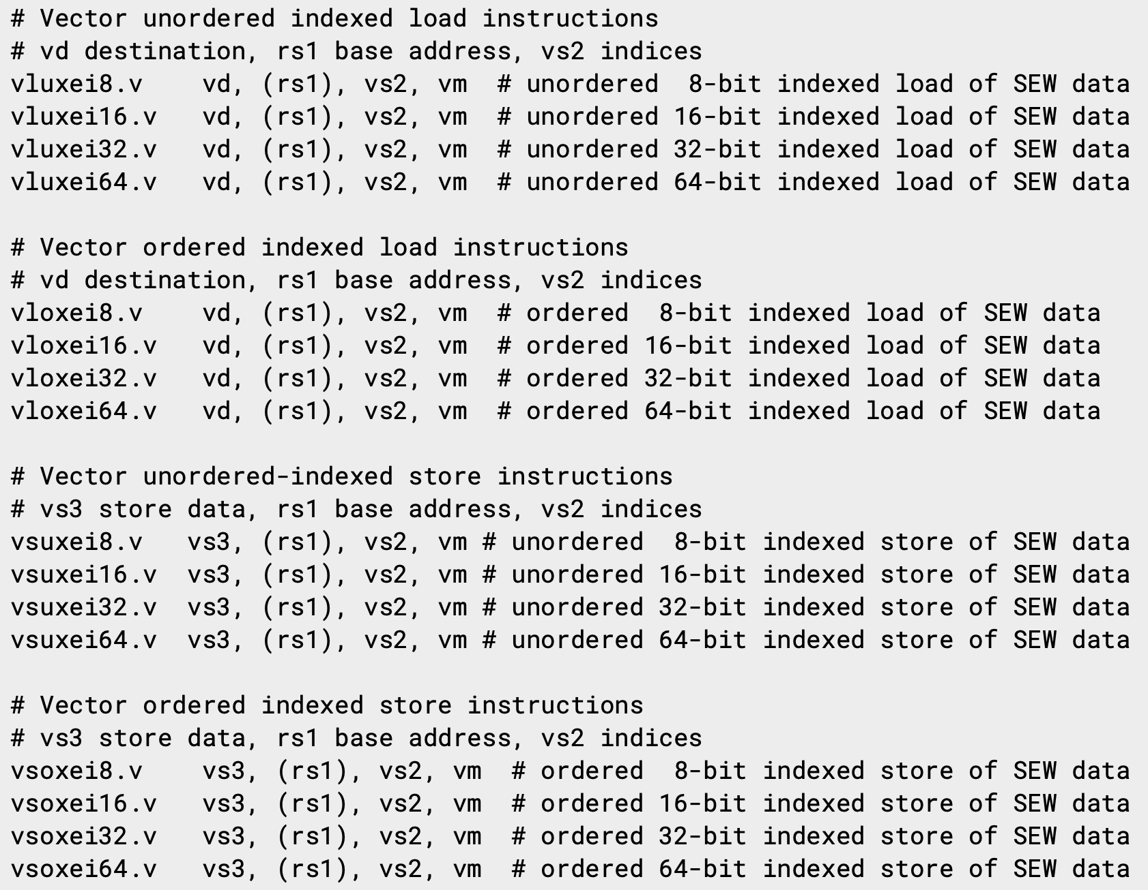
Vector Indexed Loads/Stores
Index data width encoded in instruction, while data size encoded in vtype.vsew field

Slide 15
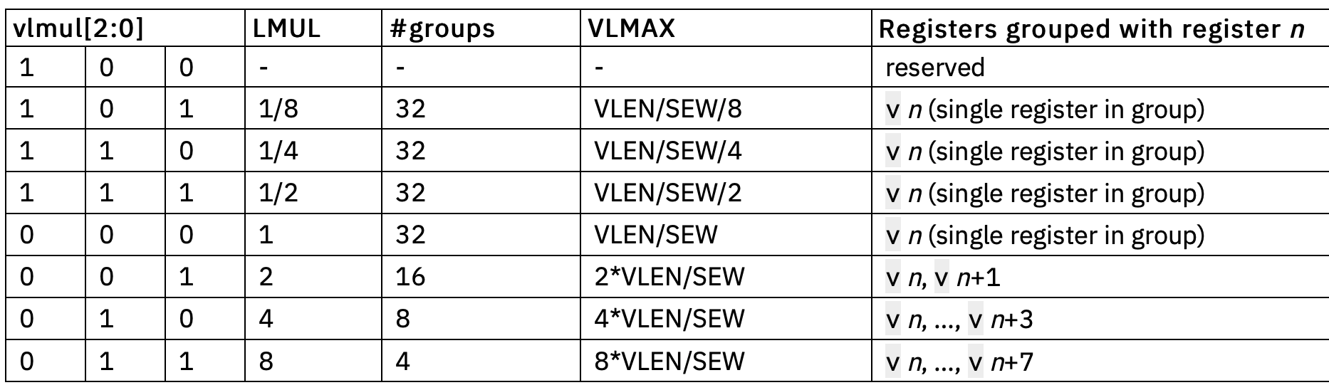
Vector Length Multiplier, LMUL
Gives fewer but longer vector registers
Called “vector register groups” – operate as single vectors
Must use even register names only for LMUL=2 (v0,v2,..), and every fourth register for LMUL=4 (v0,v4, …), etc.
Used for 1) accommodate mixed-width operations, and/or 2) to increase efficiency by using longer vectors when fewer separate registers needed
Set by vlmul[2:0] field in vtype during setvli

Slide 16
LMUL=8 stripmined vector memcpy example
Combine eight vector registers into group
(v0,v1,…,v7)
Set configuration, calculate vector strip length
Unit-stride vector load bytes
Unit-stride vector store bytes
Binary machine code can run on machines with any VLEN!

Slide 17
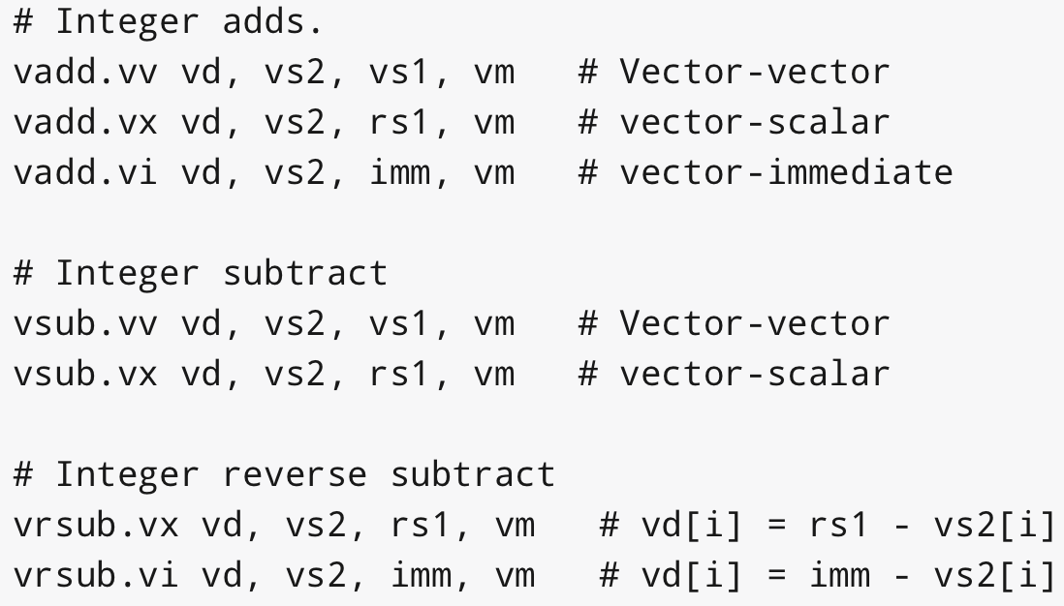
Vector Integer Add Instructions

Slide 18
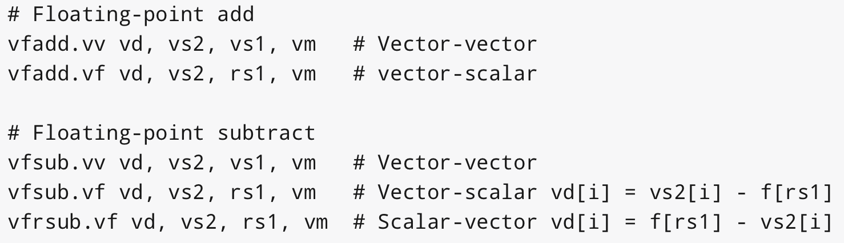
Vector FP Add Instructions
SEW can be 16b, 32b, 64b, 128b for half/single/double/quad FP
Scalar values come from floating-point f registers

Slide 19
CS152 Administrivia
PS 4 and Lab 3 due Monday April 5
Lab 4 out today!
Special Announcement, Project Prizes!
Apple donating specially engraved Airpod Pro as prizes
Awarded to top two teams in open-ended portions of labs 3,4,5

Slide 20
CS252 Administrivia
This week’s readings: Branch Prediction
Project prize, sponsored by Apple
Top team receives engraved Airpod Pros

Slide 21
Masking
Nearly all operations can be optionally under a mask (or predicate) held in vector register v0
A single vm bit in instruction encoding selects whether unmasked or under control of v0
Constrained by encoding space in 32-bit instructions
Longer 64-bit encoding extension will support predicate in any register
Integer and FP compare instructions provided to set masks into any vector register
Can perform mask logical operations between any vector registers

Slide 22
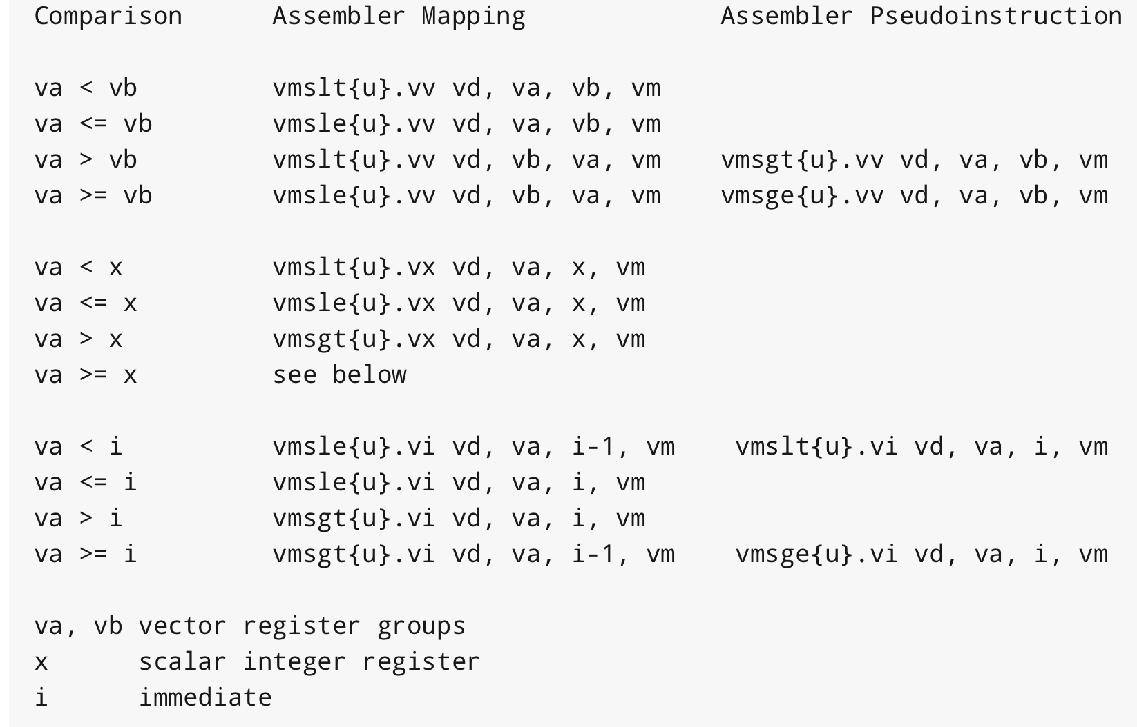
Integer Compare Instructions

Slide 23
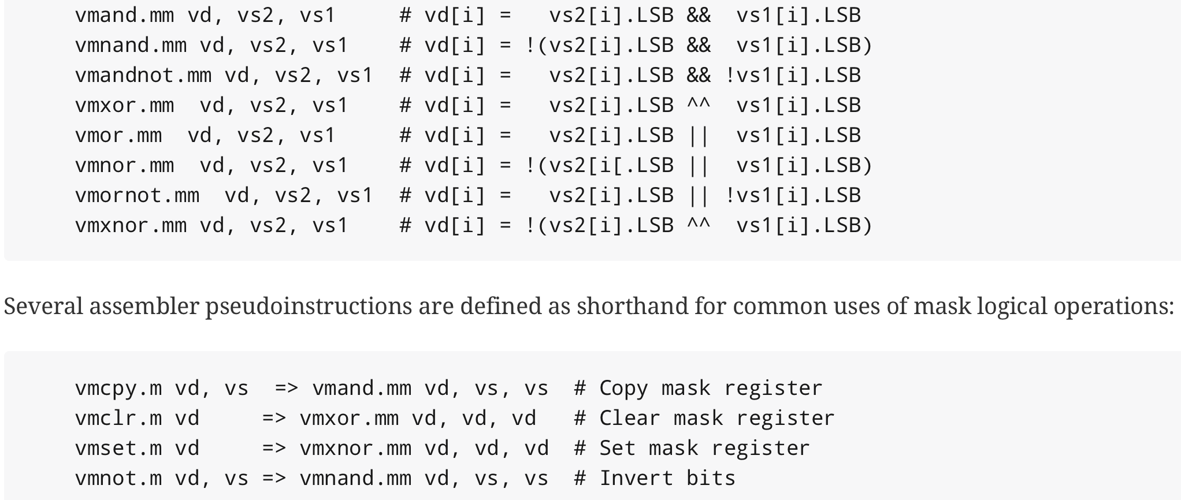
Mask Logical Operations

Slide 24
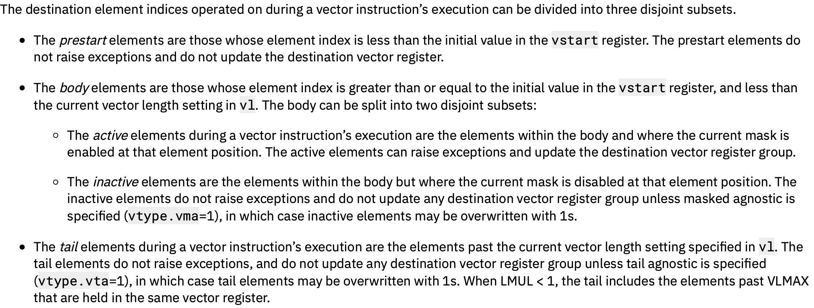
Prestart, Active, Inactive, Body, and Tail Elements

Slide 25
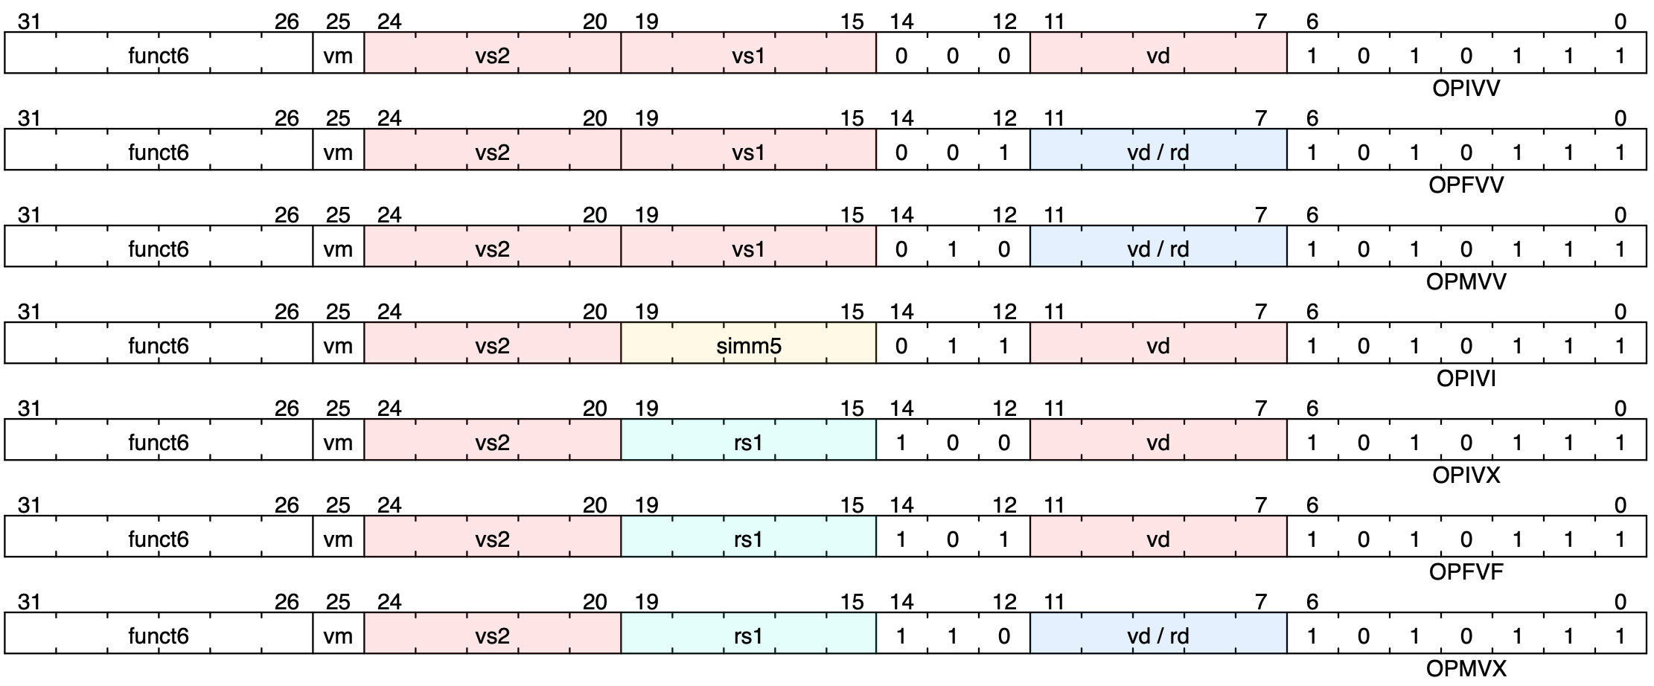
Vector Arithmetic Instruction Encodings

Slide 26
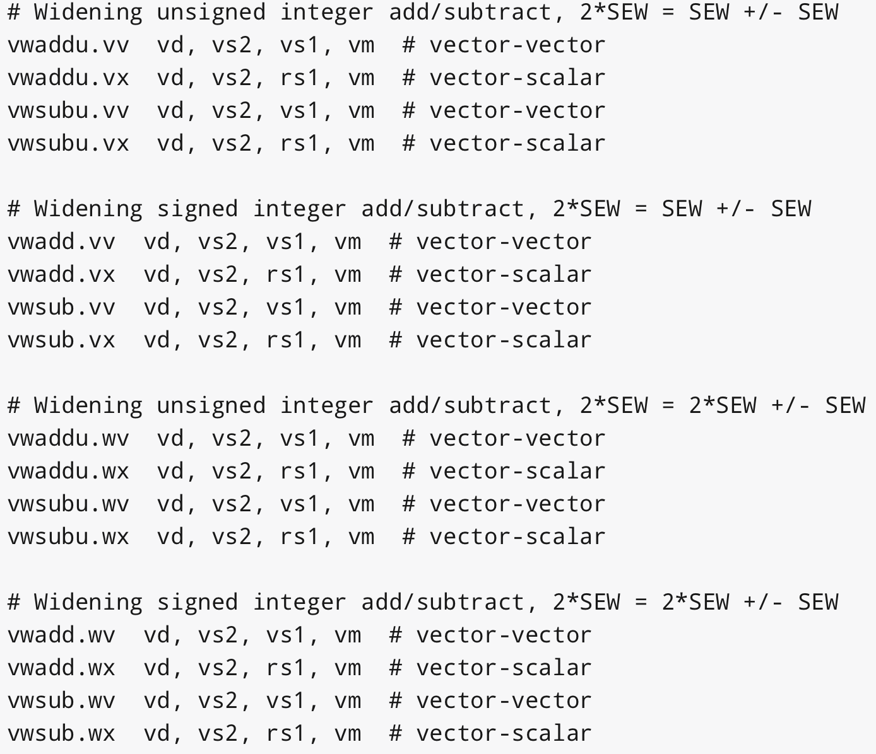
Widening Integer Add Instructions

Slide 27
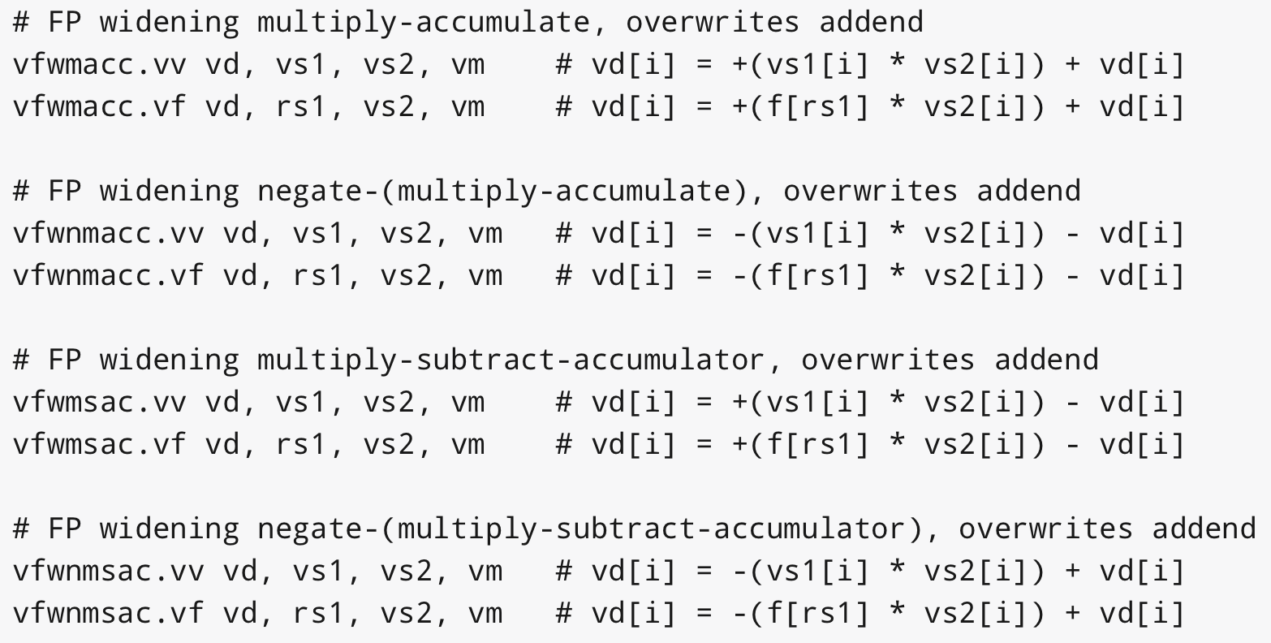
Widening FP Mul-Add

Slide 28
Mixed-Width Loops
Have different element widths in one loop, even in one instruction
e.g., widening multiply, 16b*16b -> 32b product
Want same number of elements in each vector register, even if different bits/element
Solution: Keep SEW/LMUL constant

Slide 29
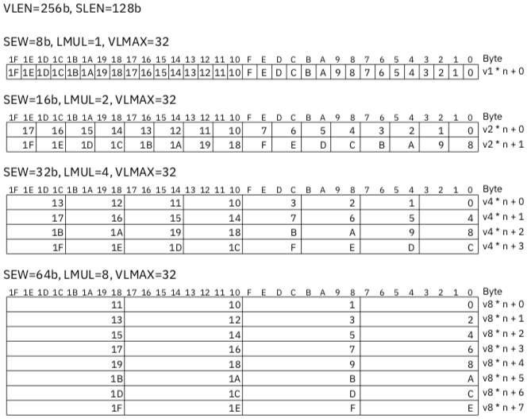
VLEN=128b
VLMAX=16
VLMAX=16
SEW/LMUL=8
VLMAX=16
VLMAX=16

Slide 30
Mask Register Layout
Masks always held in a single vector register (no groups)
Single bit per mask element, stored packed
With maximum LMUL=8 and minimum SEW=8, all bits of vector register used

Slide 31
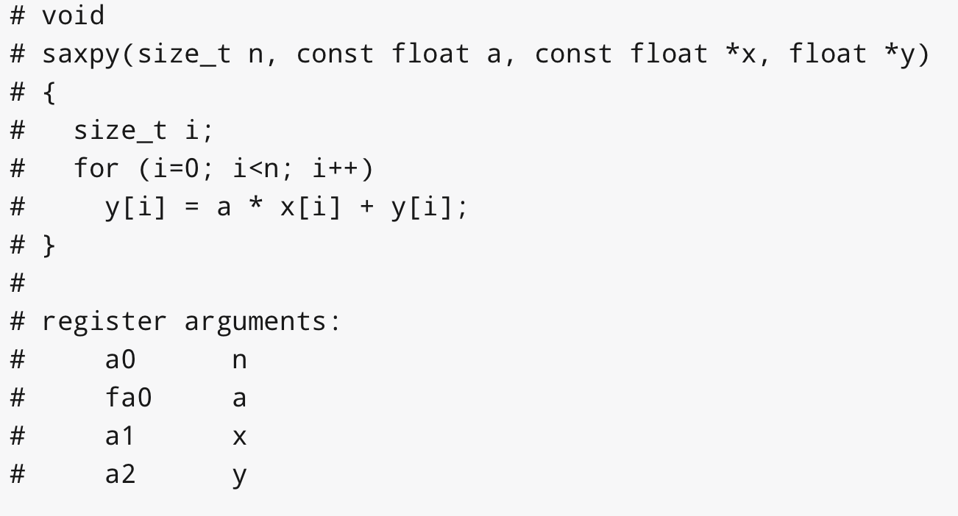
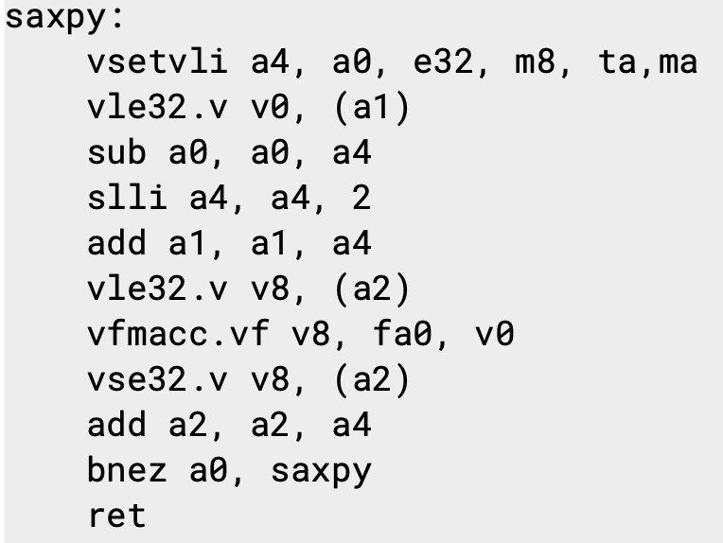
SAXPY Example

Slide 32
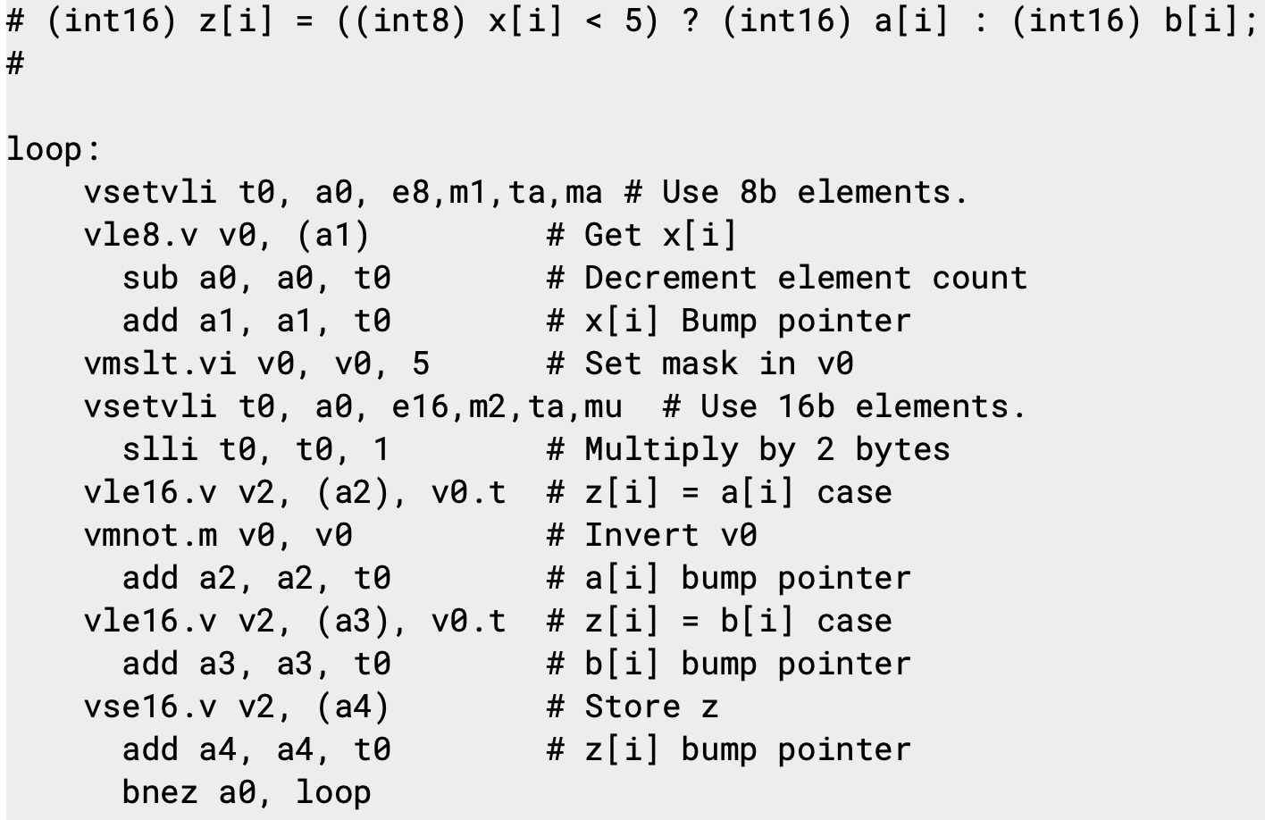
Conditional/Mixed Width Example

Slide 33
Creative Commons Licence
These lecture slides are made available under a CC SY-BA 4.0 license
https://creativecommons.org/licenses/by-sa/4.0/
Attribution Title: “RISC-V Vectors, CS152, Spring 2021”
Attribution Author: Krste Asanovic
Original content link: http://inst.eecs.berkeley.edu/~cs152/sp21/lectures/L17-RISCV-Vectors.pptx

